Slide 1
Chapter-9
Stack and Subroutines
9.1 STACK
The stack in an 8085 microcomputer system can be described as a set of memory locations in the R/W memory, specified by programmer in main memory. The beginning of the stack is defined in program by using the instruction LXI SP, 16-bit memory address of a stack.
INSTRUCTIONS
Opcode Operand
LXI SP, 16-bit memory address of a stack
PUSH Rp
PUSH B
PUSH D
PUSH H
PUSH PSW

Slide 2
Opcode Operand
POP Rp
POP B
POP D
POP H
POP PSW
9.2 SUBROUTNE
A subroutine is a group of instructions written separately from main program to perform a function that occurs repeatedly in the main program. A subroutine is like a procedure or function of a high-level language and it is called using the instruction CALL 16-bit memory address of a subroutine.
INSTRUCTIONS
Opcode Operand
CALL 16-bit memory address of a subroutine
RET

Slide 3
9.21 Illustrative Program: Traffic Signal Controller
PROBLEM SATEMENT
Write a program to provide the given on/off time to three traffic lights (Green, Yellow, and Red) and two pedestrian signs (WALK and DON’T WALK). The signal lights and signs are turned on/off the data bits of an output port as shown below:
Lights Data Bits On Time
1.Green D0 15 seconds
2.Yellow D2 5 seconds
3. Red D4 20 seconds
4. WALK D6 15 seconds
5. DON’T WALK D7 25 seconds

Slide 4
PROBLEM ANALYSIS
DON’T
Time WALK WALK Red Yellow Green Hex
0 D₇ D₆ D₅ D₄ D₃ D₂ D₁ D₀
(15)
15 0 1 0 0 0 0 0 1 = 41H
(5)
20 1 0 0 0 0 1 0 0 = 84H
(20)
40 1 0 0 1 0 0 0 0 = 90H

Slide 5
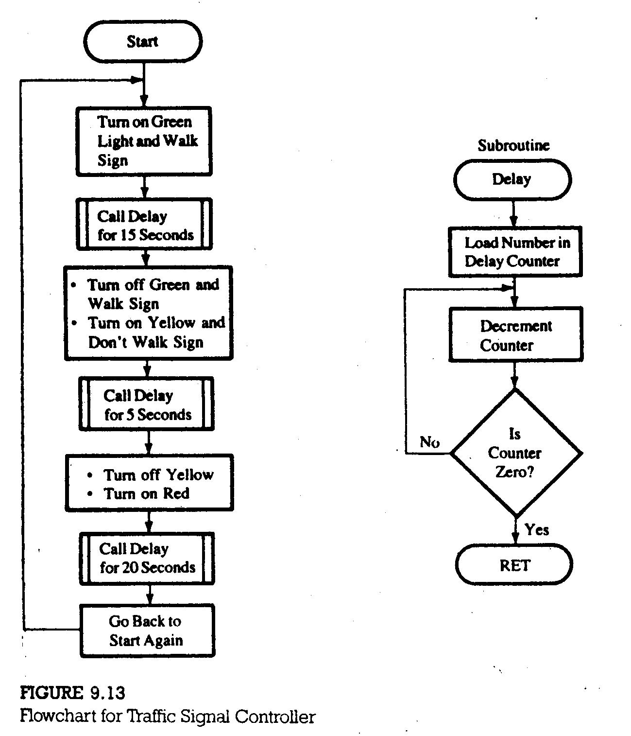

Slide 6
PROGRAM
LXI SP, XX99H
START: MVI A, 41H
OUT PORT#
MVI B, 0FH
CALL DELAY
MVI A, 84H
OUT PORT#
MVI B, 05H
CALL DELAY
MVI A, 90H
OUT PORT#
MVI B, 14H
CALL DELAY
JMP STATR

Slide 7
DELAY: PUSH D
PUSH PSW
SECOND: LXI D, COUNT
CALL DELAY
LOOP: DCX D
MOV A,D
ORA E
JNZ LOOP
DCR B
JNZ SECOND
POP PSW
POP D
RET

